Slide 1


How accurately can we predict mental health conditions in employees who work remotely?
Nikola Ivanov - Ilija Trajkovski - Berat Ahmetaj

Slide 2

Background: Remote work is becoming increasingly common, but it brings unique challenges to workers' mental well-being.
Objective: To explore how accurately we can predict mental health outcomes in remote workers using survey data on stress, isolation, and job satisfaction.
Significance: Understanding these factors can help organizations better support remote workers and create healthier work environments.
Focus: International remote workers and their mental health outcomes in relation to their work environment and social factors.

Slide 3
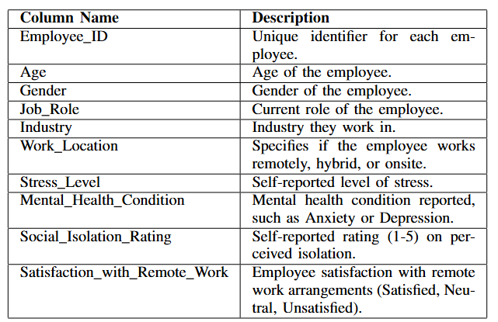

Dataset Overview
Source: Survey data from 5,000 remote employees worldwide.
Data Preprocessing
Categorical variables encoded numerically.
Numerical features normalized.
Missing values imputed.
data from 5,000 remote employees worldwide & survey data from 100 remote employees.

Slide 4
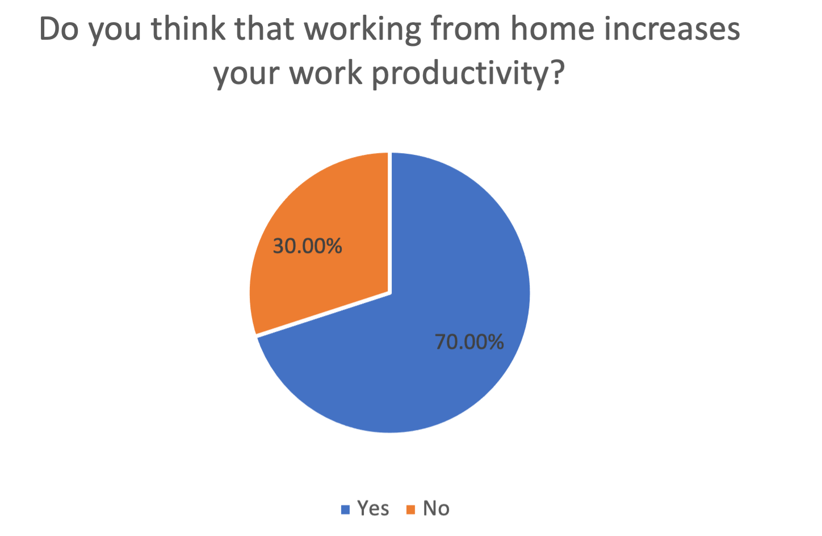
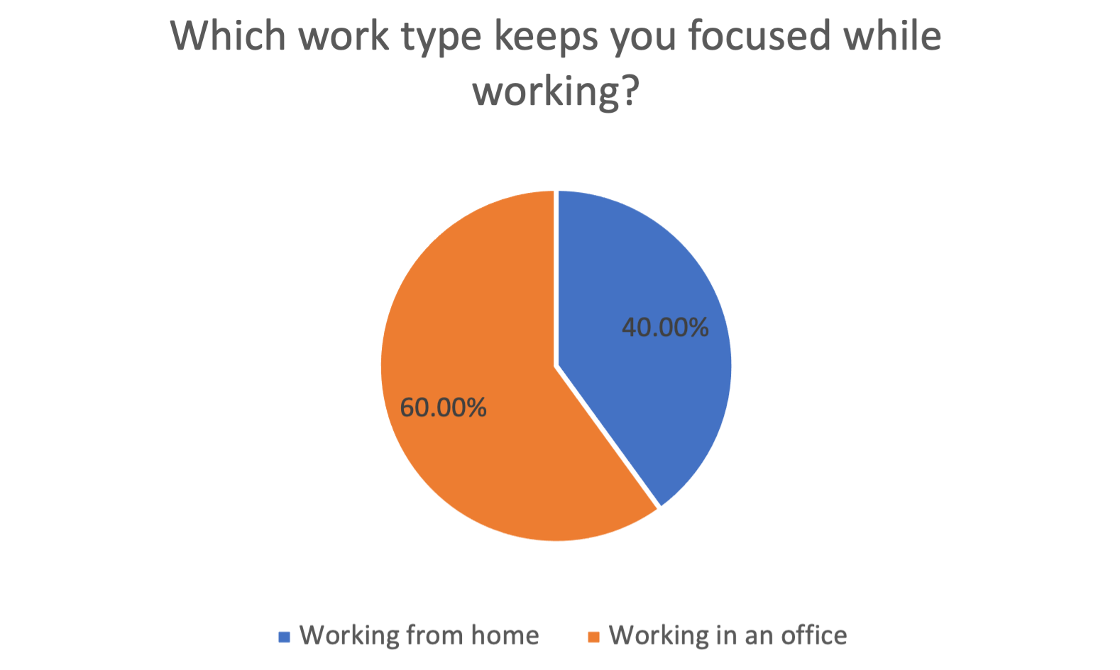
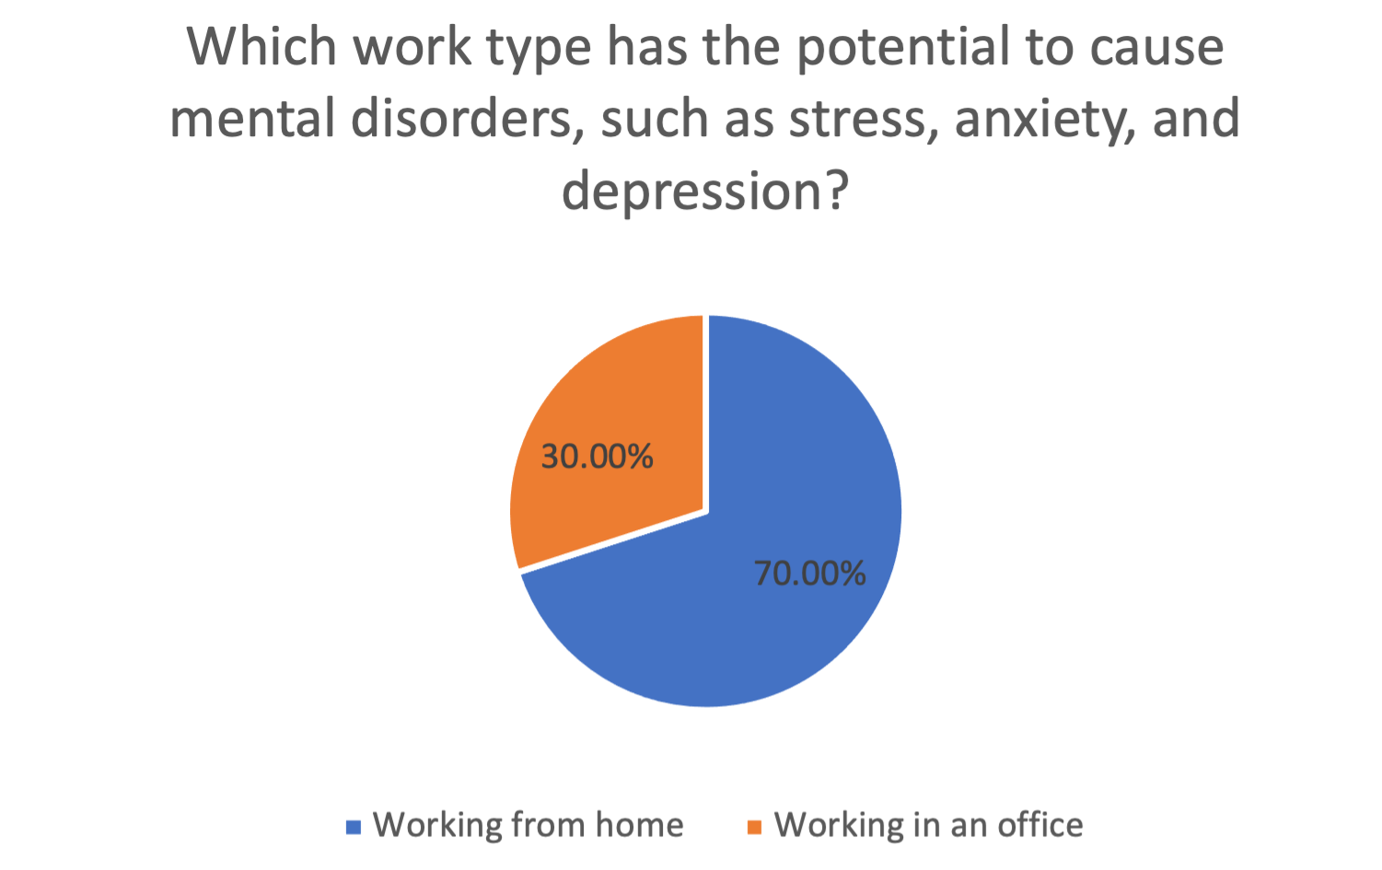
Work-from-home experience: 40% positive, 60% negative. Productivity: 70% felt more productive at home. Social and lifestyle impacts: 70% reported reduced social interaction. 100% appreciated flexibility of remote work. 70% felt remote work prevented going out. 60% preferred office focus over remote work (40%). Mental health: 70% linked remote work to mental health issues, 30% to office work. Work preference: 50% preferred hybrid, 30% office, 20% remote.
Source: Survey data from 5,000 remote employees worldwide.
Questionnaire Insights

Slide 5
Machine Learning Methods
Source: Survey data from 5,000 remote employees worldwide.
Logistic Regression (LR):
Support Vector Machines (SVM):
Used to predict mental health conditions (e.g., anxiety, depression).
Estimates probability of mental health outcomes based on stress, isolation, and satisfaction.
Provides insights into significant predictors for mental health risks.
Used for classification (mental health condition vs. no condition).
Handles non-linear relationships using kernel tricks.
SMOTE applied to address class imbalance by oversampling minority class (mental health issues).

Slide 6
Example Case:
Source: Survey data from 5,000 remote employees worldwide.
Fully Remote: High stress (4.2), isolation (4.5), low job satisfaction (3.1).
Hybrid: Moderate stress (3.6), isolation (3.1), high job satisfaction (4.0).
Onsite: Moderate stress (3.8), isolation (2.7), moderate satisfaction (3.7).
Logistic Regression Findings:
Fully Remote: Stress (5), isolation (4.8) → 70% probability of mental health issues.
Hybrid: Stress (3.2), isolation (3.0) → 15% probability of mental health issues.

Slide 7
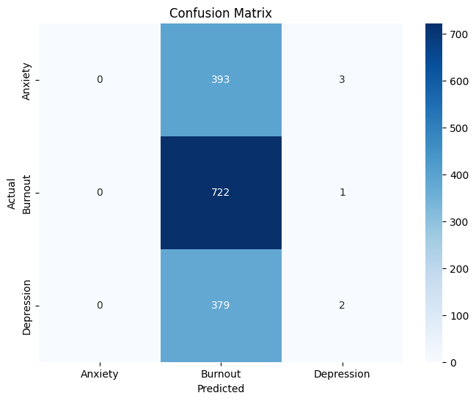
Accuracy Increased from 0.3 to 0.4 after applying SMOTE. Key Findings: Positive predictors of better mental health: Sales and Software Engineer roles, IT and Retail industries, mental health resources, and regions like Asia. Negative predictors: Designer roles, Healthcare industry, poor sleep quality, and medium stress levels. Key Insight: Logistic Regression effectively predicted "Burnout" instances (722 identified).
Source: Survey data from 5,000 remote employees worldwide.
Logistic Regression Results

Slide 8
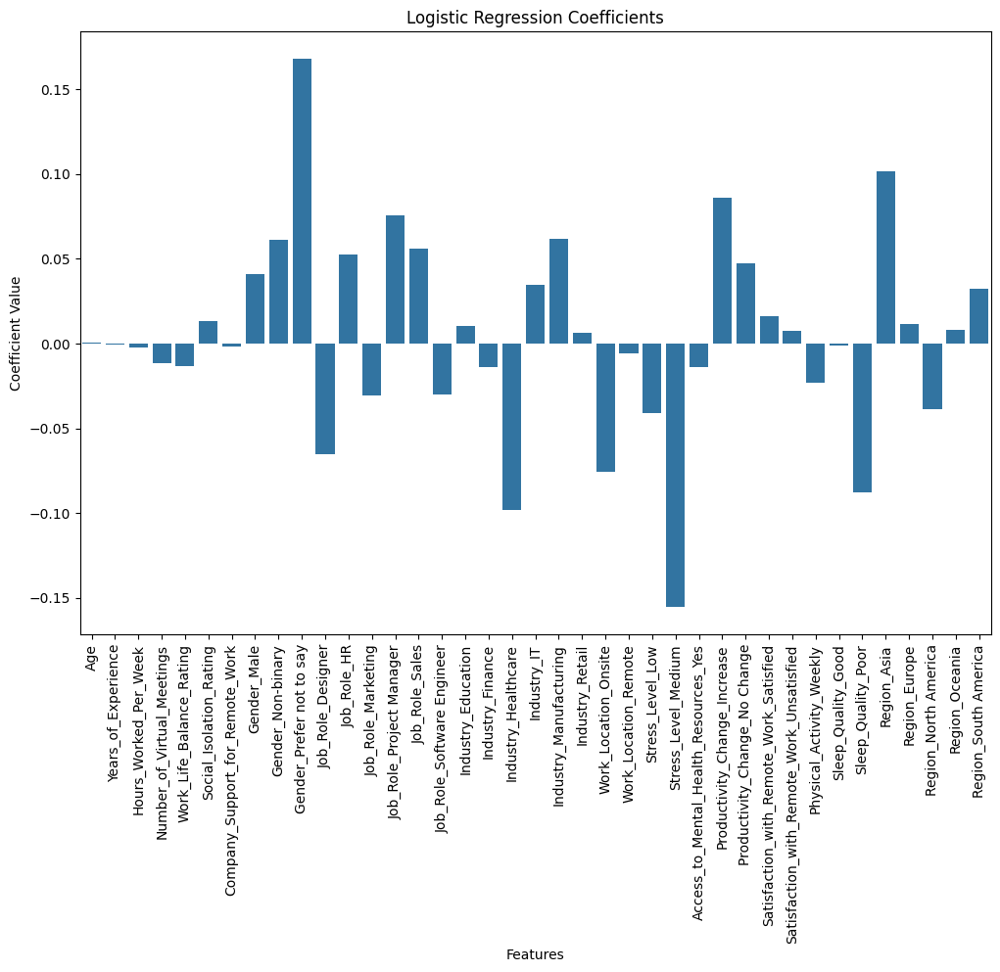
Positive predictors of better mental health: Sales and Software Engineer roles, IT and Retail industries, mental health resources, and regions like Asia. Negative predictors: Designer roles, Healthcare industry, poor sleep quality, and medium stress levels.
Source: Survey data from 5,000 remote employees worldwide.
Logistic Regression Results

Slide 9
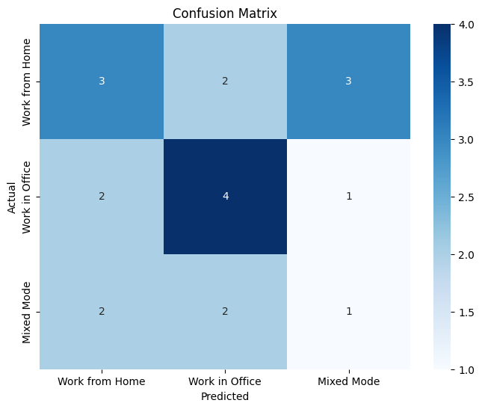
Accuracy: Achieved 0.5 accuracy. Prediction Challenges: High accuracy for office workers. Moderate accuracy for remote workers. Poor accuracy for hybrid workers—variability in individual experiences likely caused this.
Source: Survey data from 5,000 remote employees worldwide.
Support Vector Machine Results

Slide 10
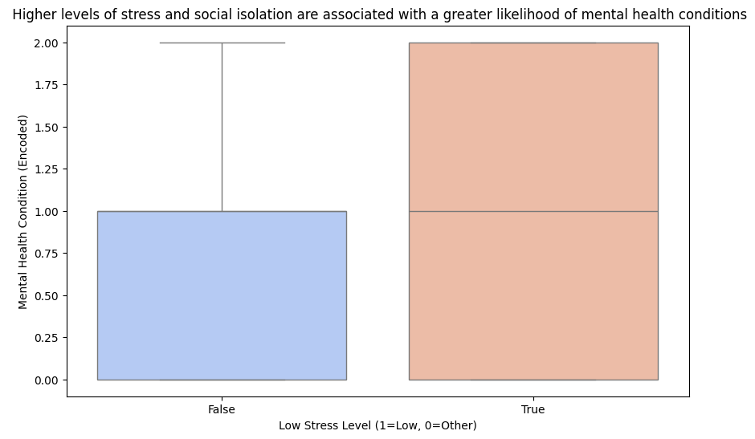
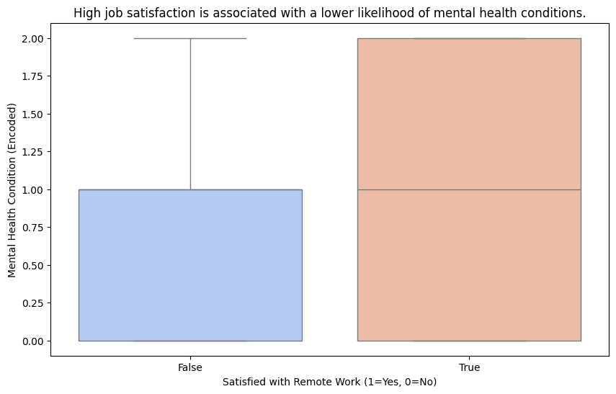
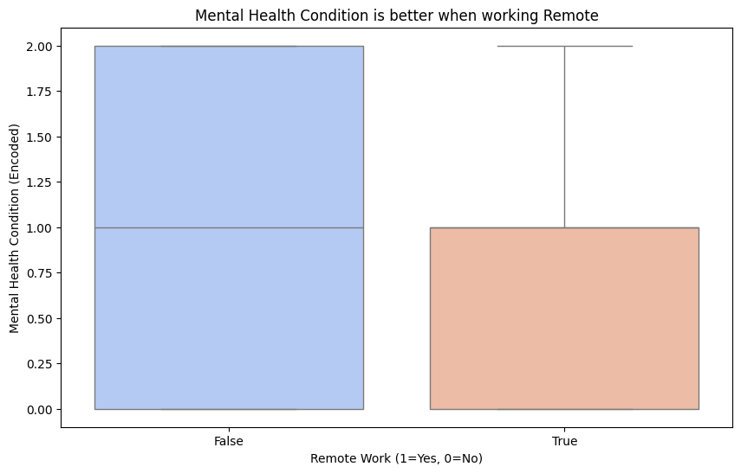
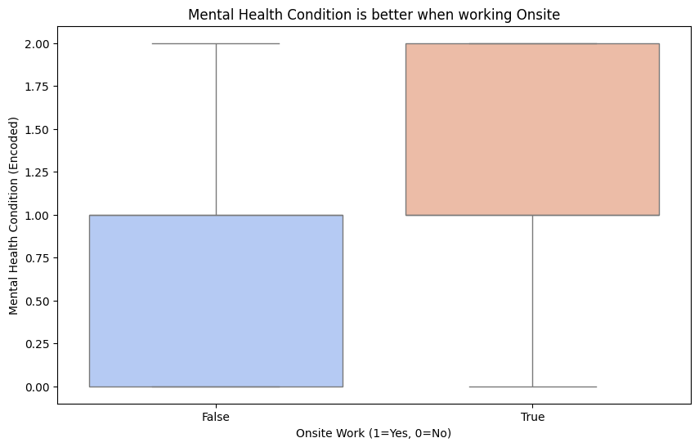
High job satisfaction reduces mental health issues Supported Mental health is better onsite: Mixed (varied responses) Mental health is better remote: Not Supported Stress and isolation increase mental health issues: Supported
Source: Survey data from 5,000 remote employees worldwide.
Hypothesis Testing Results

Slide 11

Source: Survey data from 5,000 remote employees worldwide.

